Slide 1
Breast Cancer Wisconsin (Diagnostic) Data Set
Group1 108753127 許育庭
108753102 吳映函
108753144 陳瑀芋

Slide 2
Goal
Predict whether the cancer is benign or malignant

Slide 3
Data
Input format: .csv
30 columns features
569 rows
All feature values are recoded with four significant digits.
Missing attribute values: none
Class distribution: 357 benign, 212 malignant
https://www.kaggle.com/uciml/breast-cancer-wisconsin-data

Slide 4
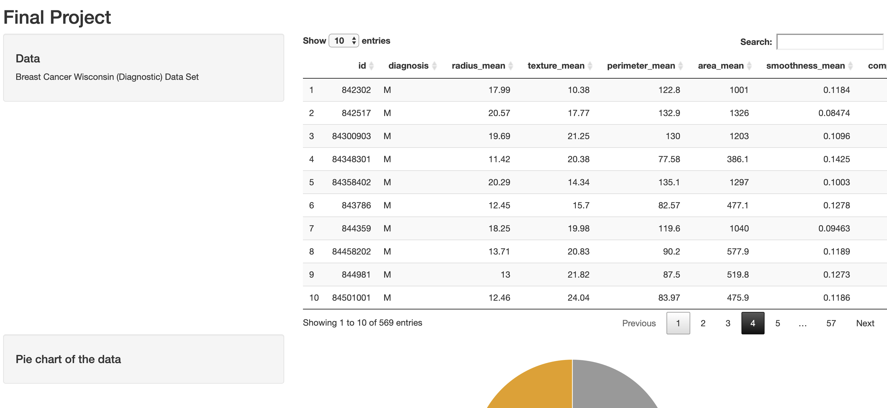
Shiny

Slide 5
Features
radius
texture
perimeter
area
smoothness
compactness
concavity
concave points
symmetry
fractal dimension
_mean
_standard error
_worst

Slide 6
Method
Model
Decision tree
Naïve Bayes
K-Nearest Neighbor Classification(KNN)
Random Forest
Generalized Boosted Regression Modeling (GBM)
Support Vector Machines (SVM)
PCA + LDA
Null model
Guess all benign
https://www.kaggle.com/mirichoi0218/classification-breast-cancer-or-not-with-15-ml https://www.kaggle.com/shravank/predicting-breast-cancer-using-pca-lda-in-r

Slide 7
Performance
Without cross validation
Model_name | AUC_score
null | 0.5
rpart | 0.945
nb | 0.932
knn | 0.967
rf | 0.916
gbm | 0.983
svm | 0.962
https://www.kaggle.com/mirichoi0218/classification-breast-cancer-or-not-with-15-ml

Slide 8
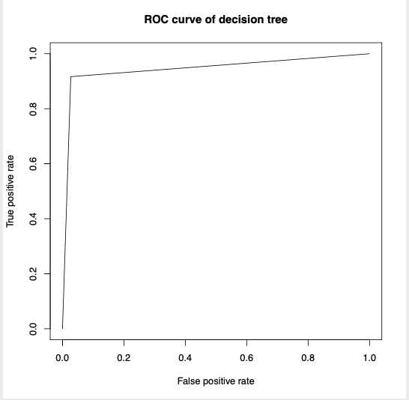
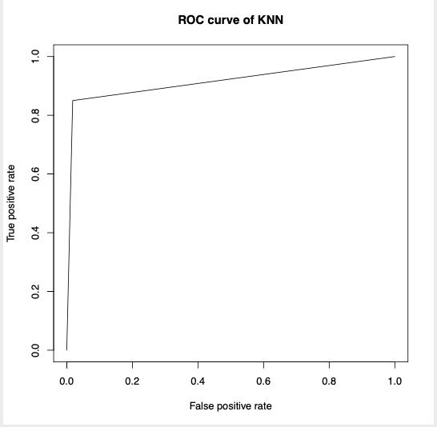
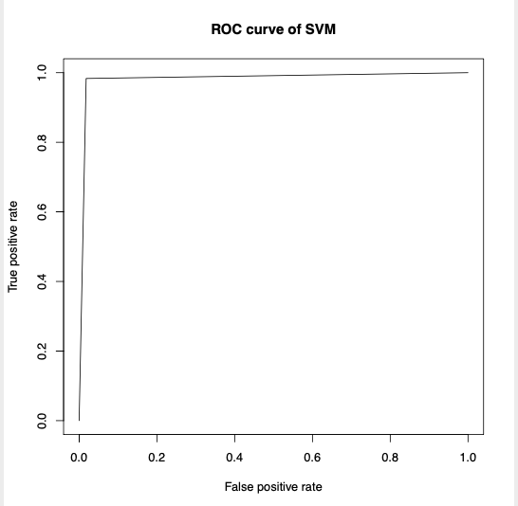
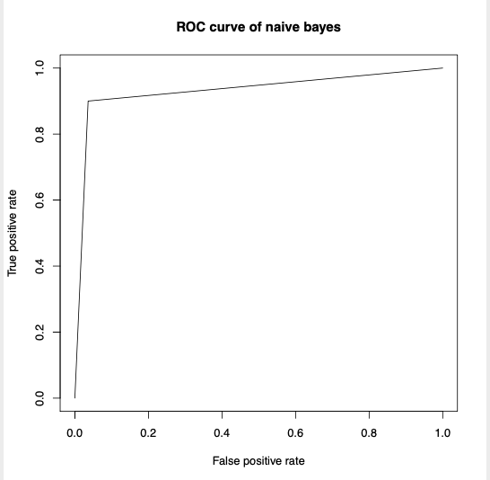
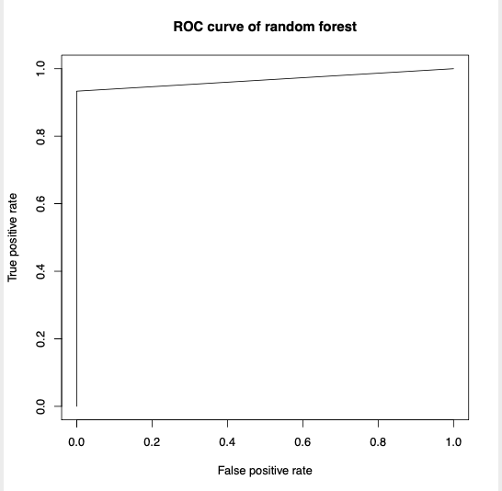
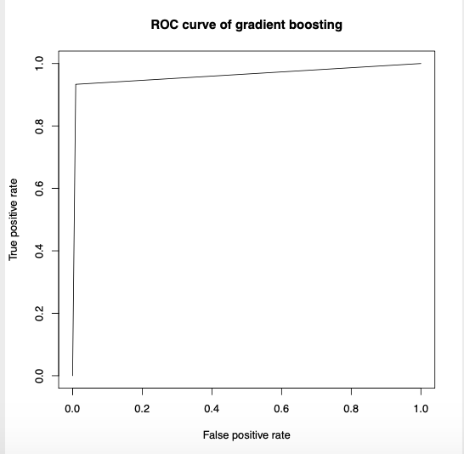
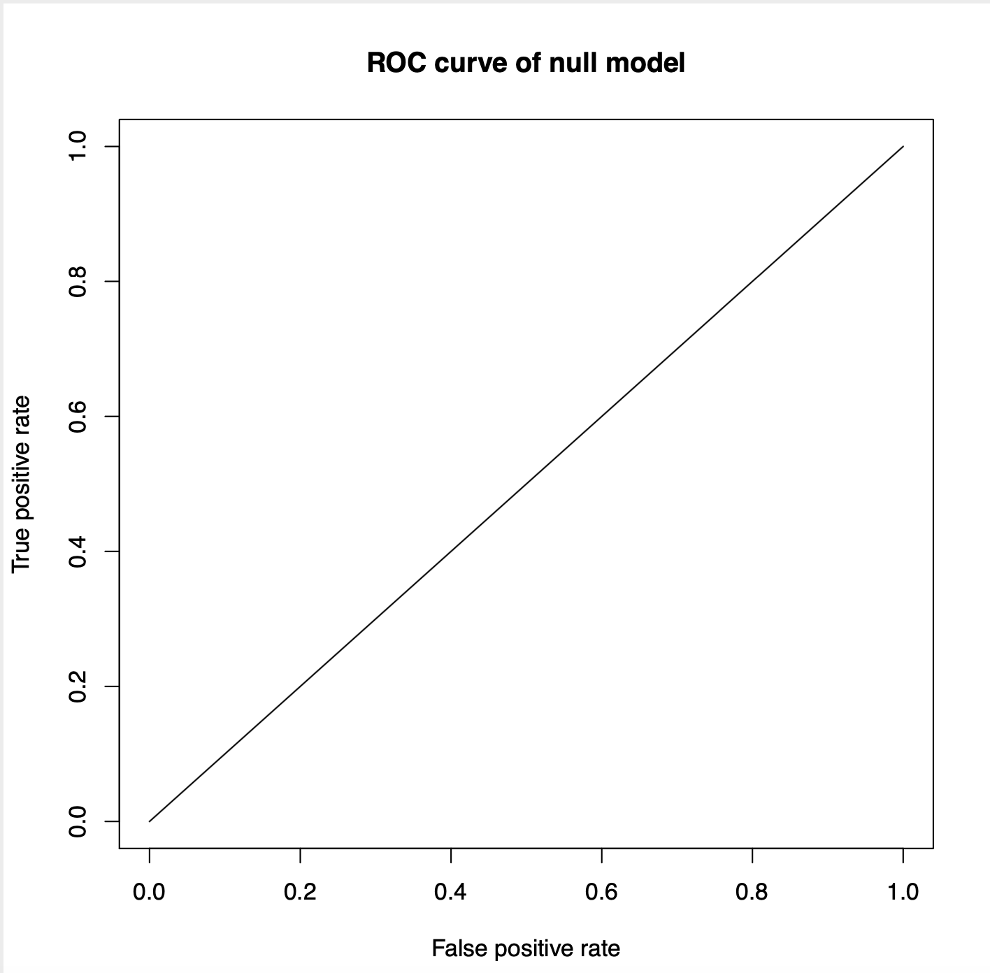
ROC
https://www.kaggle.com/mirichoi0218/classification-breast-cancer-or-not-with-15-ml

Slide 9
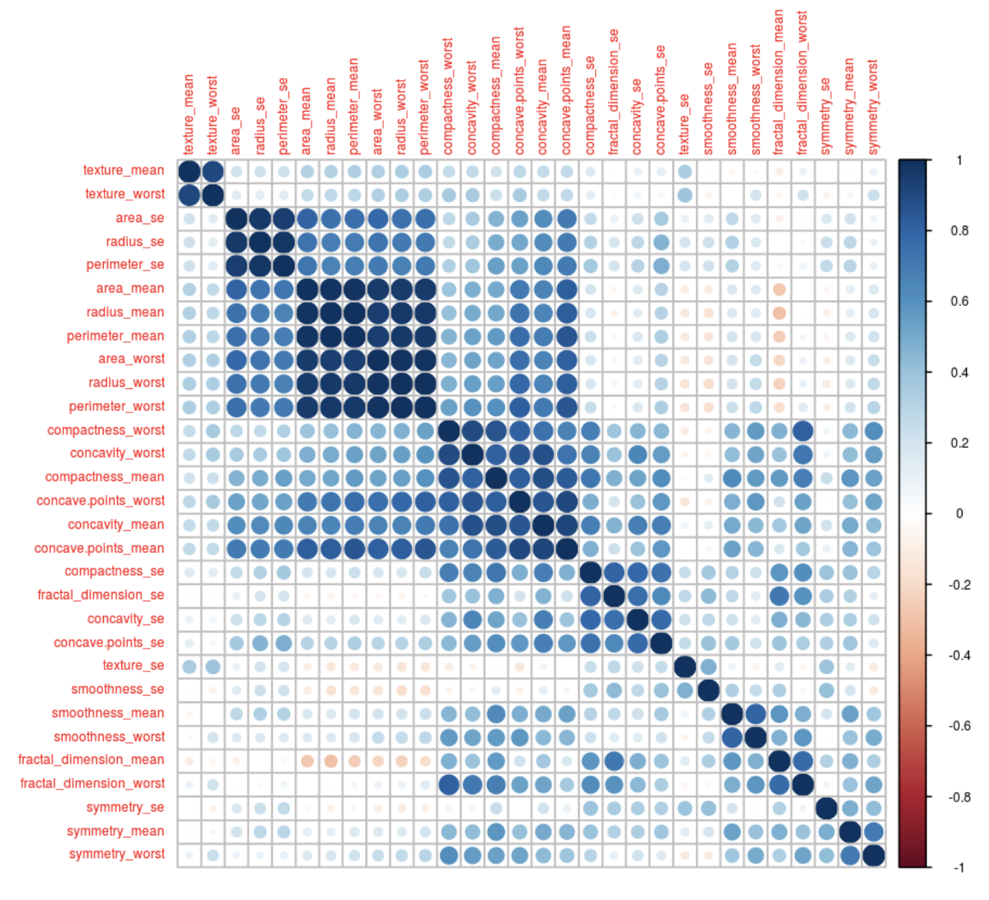
Correlation of the features
Tried to selected features
PCA

Slide 10
5-fold Cross Validation
All features
models | bestval | valauc | testauc
rpart | 1 | 0.957 | 0.968
nb | 1 | 0.95 | 0.933
knn | 1 | 0.962 | 0.97
rf | 1 | 0.969 | 0.958
gbm | 2 | 0.968 | 0.886
svm | 4 | 0.988 | 0.962
Selected features (remove one of the feature while both features are over 0.75)
models | bestval | valauc | testauc
rpart | 2 | 0.912 | 0.918
nb | 1 | 0.914 | 0.882
knn | 1 | 0.945 | 0.956
rf | 1 | 0.952 | 0.951
gbm | 4 | 0.953 | 0.943
svm | 1 | 0.945 | 0.963

Slide 11
SVM performance (compares with null model)
Null model result
Sensitivity | Specificity | Accuracy
1.0000 | 0.0000 | 0.628
Fold set:4
Validation data
Sensitivity | Specificity | Accuracy
1.0000 | 0.9762 | 0.9912
Test data
Sensitivity | Specificity | Accuracy
0.9718 | 0.9524 | 0.9646

Slide 12
PCA + LDA(Linear discriminant analysis )
https://www.kaggle.com/shravank/predicting-breast-cancer-using-pca-lda-in-r

Slide 13
PCA + LDA
6-fold Cross Validation
set | train | val | test
1 | 0.992 | 0.9972 | 0.9957
2 | 0.9939 | 0.9947 | 0.994
3 | 0.9913 | 0.994 | 0.9995
4 | 0.9919 | 1 | 0.9826
5 | 0.9966 | 0.9793 | 0.966
6 | 0.9926 | 0.9678 | 0.9972
avg. | 0.9931 | 0.9888 | 0.9891
Fold set:4
Test data
Sensitivity | Specificity | Accuracy
0.9667 | 0.9714 | 0.9684

Slide 14
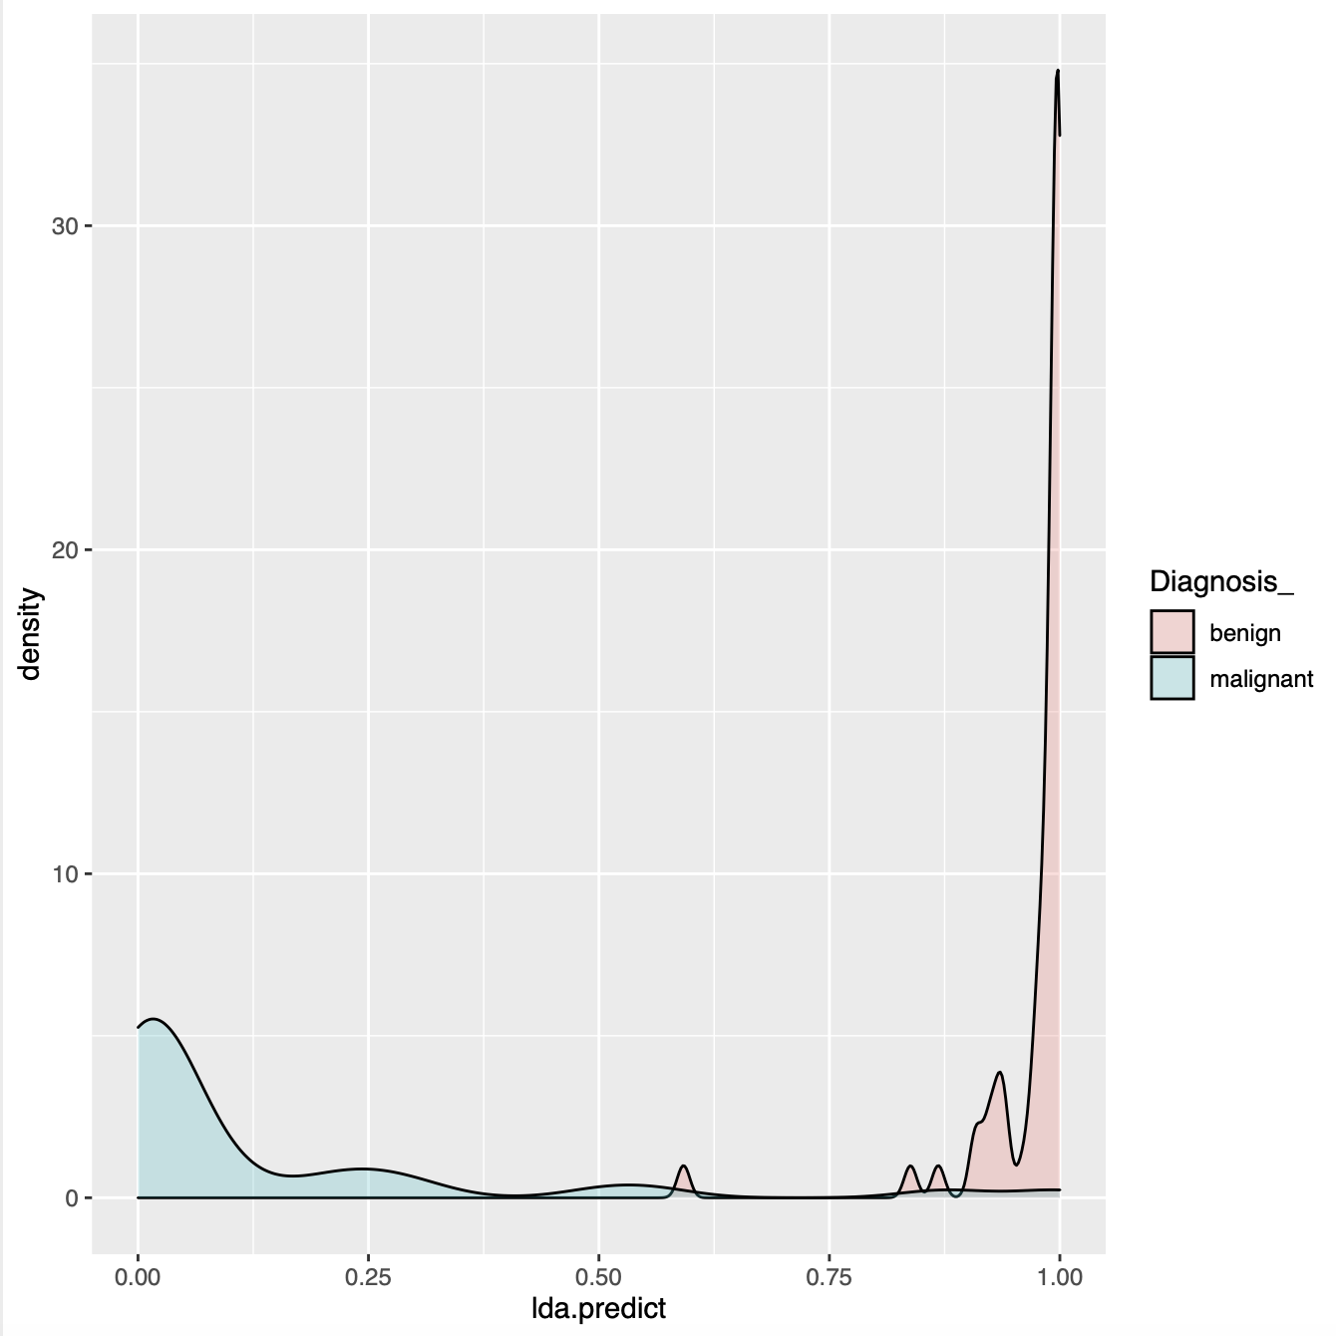
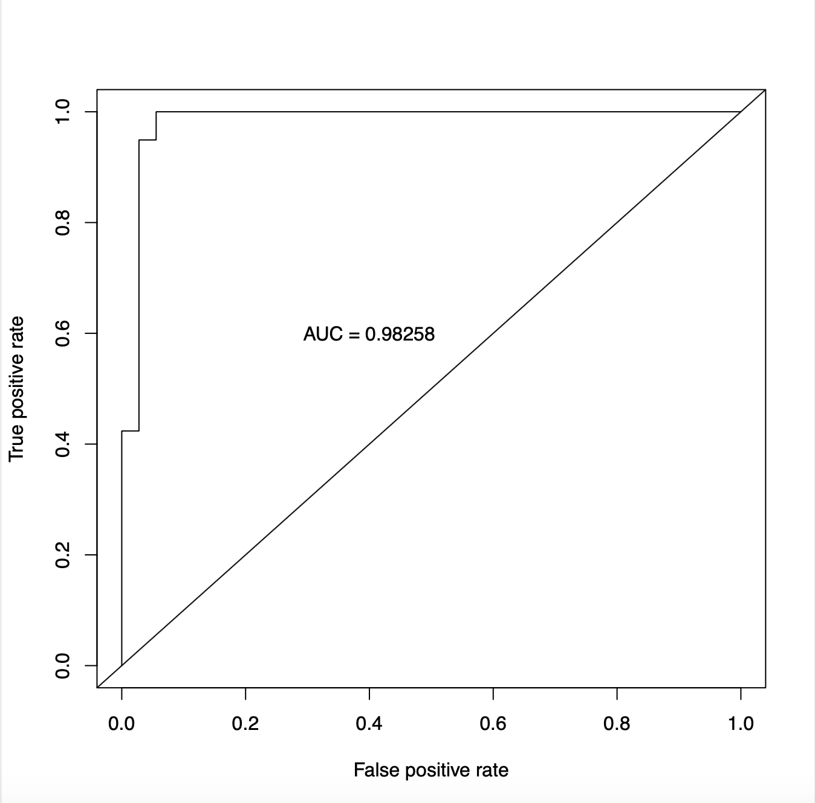
PCA + LDA
https://www.kaggle.com/shravank/predicting-breast-cancer-using-pca-lda-in-r

Slide 15
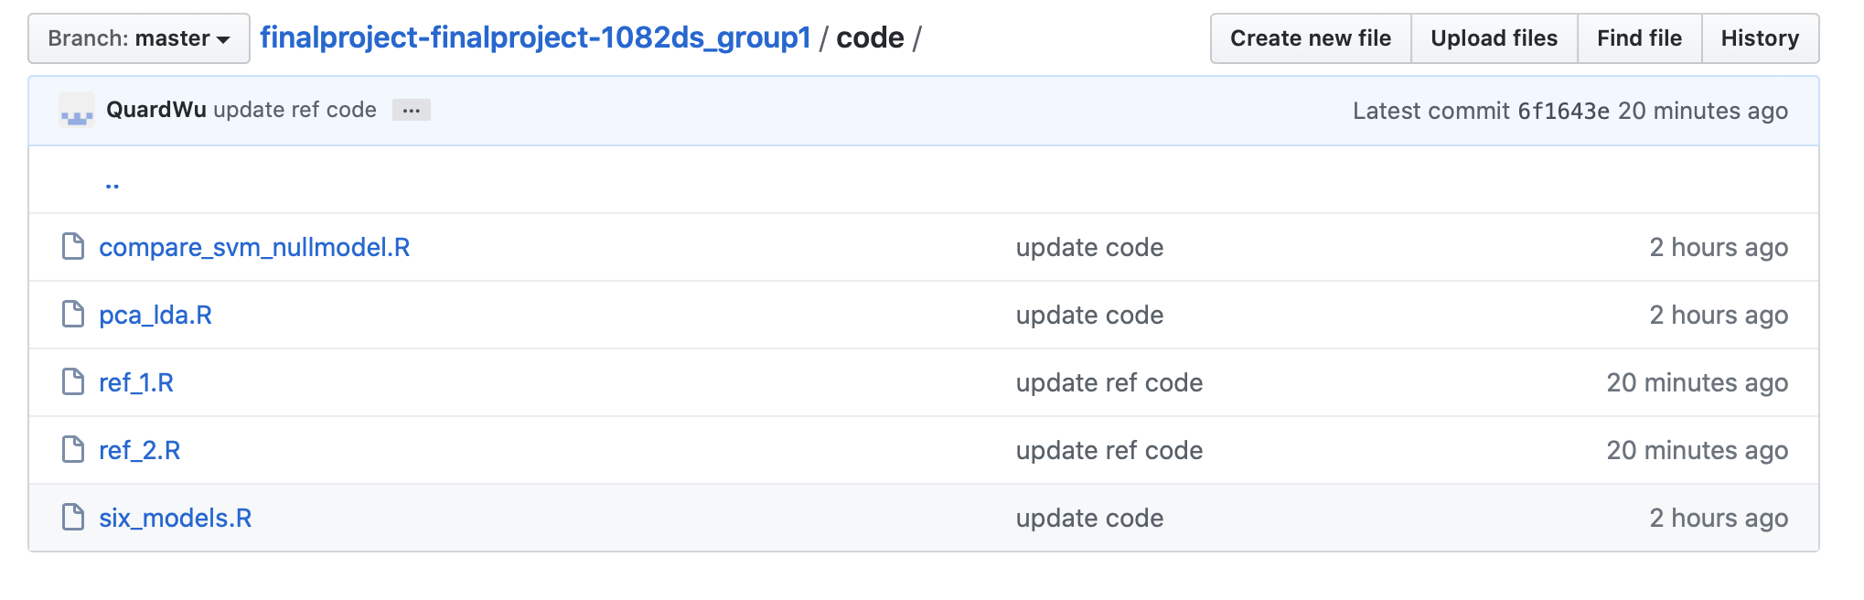
Code

Slide 16
Challenge
It is hard to select the feature, we make efforts to do that.
We still need to refer to others.
Try methods and compare the difference.

Slide 17
Reference
https://www.kaggle.com/shravank/predicting-breast-cancer-using-pca-lda-in-r
https://www.kaggle.com/mirichoi0218/classification-breast-cancer-or-not-with-15-ml
https://www.kaggle.com/paultimothymooney/decision-trees-for-binary-classification-0-99
https://www.kaggle.com/kanncaa1/statistical-learning-tutorial-for-beginners/data
https://www.kaggle.com/kanncaa1/statistical-learning-tutorial-for-beginners/notebook
https://www.kaggle.com/bbloggsbott/feature-selection-correlation-and-p-value/input
https://www.kaggle.com/uciml/breast-cancer-wisconsin-data/kernels

